Slide 1
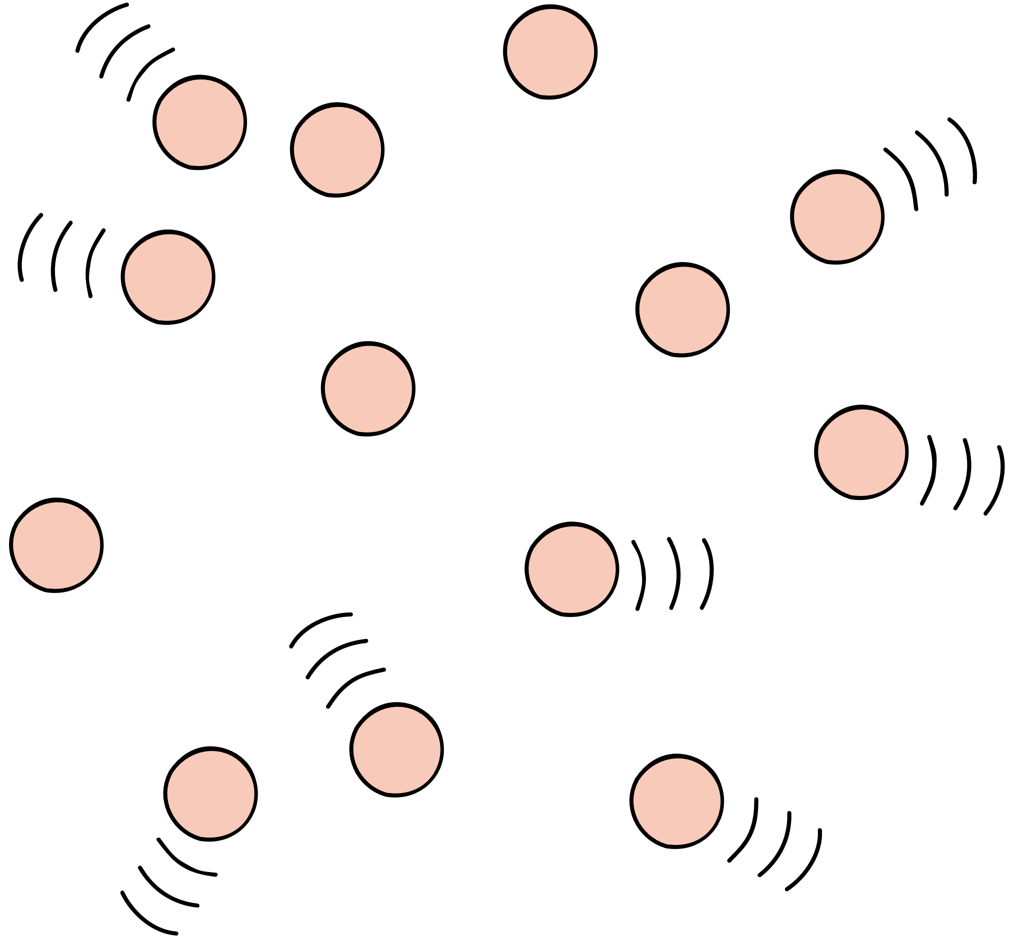

Modal Verbs

Slide 2
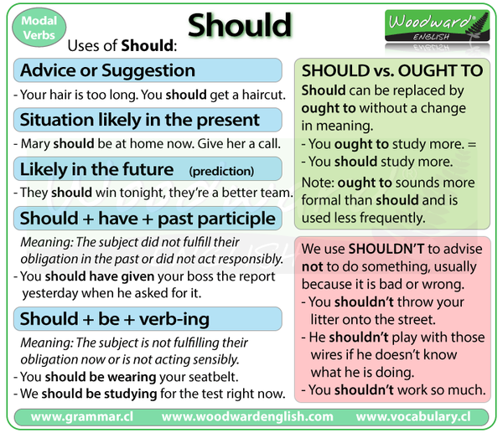


Slide 3

We also use should / ought to + have + past participle to talk about an expectation that something happened, has happened, or will happen:
For e.g.
The builders should / ought to have finished by the end of the week.

Slide 4

We use had better instead of should / ought to, to say that we think it would be sensible or advisable to do something.
We don't use HAD BETTER to talk about
the past or to make general comments.
For e.g.
You should / ought to have caught a later train.
(not You had better have...)

Slide 5

When we make a logical conclusion from some situation or activity, we use must not should or ought to
E.g. You must be mad if you think I'm going to lend you any more money.

Slide 6
Use of Supposed to
We can use (be) supposed to to talk about an obligation to do something.
We use (be) supposed to when we report what many people think is true
e.g. I'm supposed to be there at 10.00. • The work was supposed to start last week.

Slide 7
Will and Willing : willingness
"Will" is commonly used to express willingness or a voluntary action in the future.
Example: I will help you with your homework.
er all items.
"Would" is often used to express a polite or conditional willingness.
Example: I would be happy to assist you if you need help.

Slide 8
Likelihood:
When used to talk about the future, "will" can indicate a high degree of likelihood or a strong prediction.
Example: The sun will rise in the east tomorrow.
Would" can express a conditional likelihood or a hypothetical situation.
Example: If it rains, she would stay at home.

Slide 9
Certainty
"Will" can express a strong level of certainty when used in predictions or statements about the future.
Example: She will definitely be at the meeting on time.
"Would" is generally used in situations that are more hypothetical or less certain than those where "will" is used.
Example: If I won the lottery, I would travel the world.

Slide 10

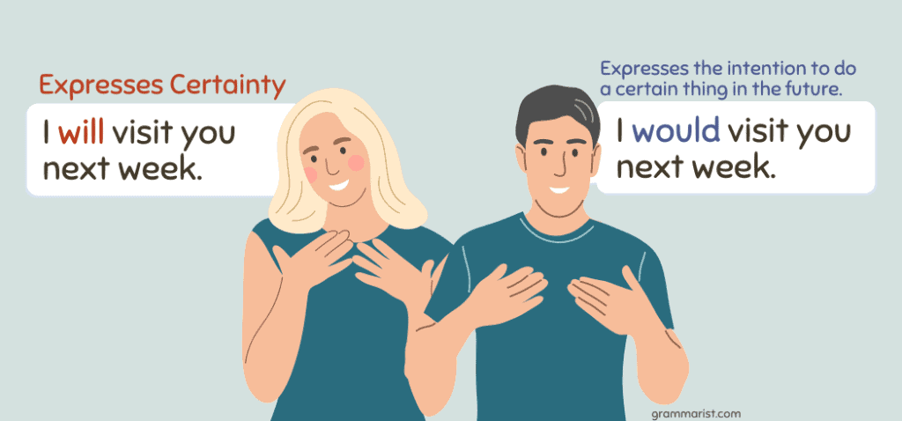
Identify the
Process
Identify the process that changes
the state of matter.

Slide 11
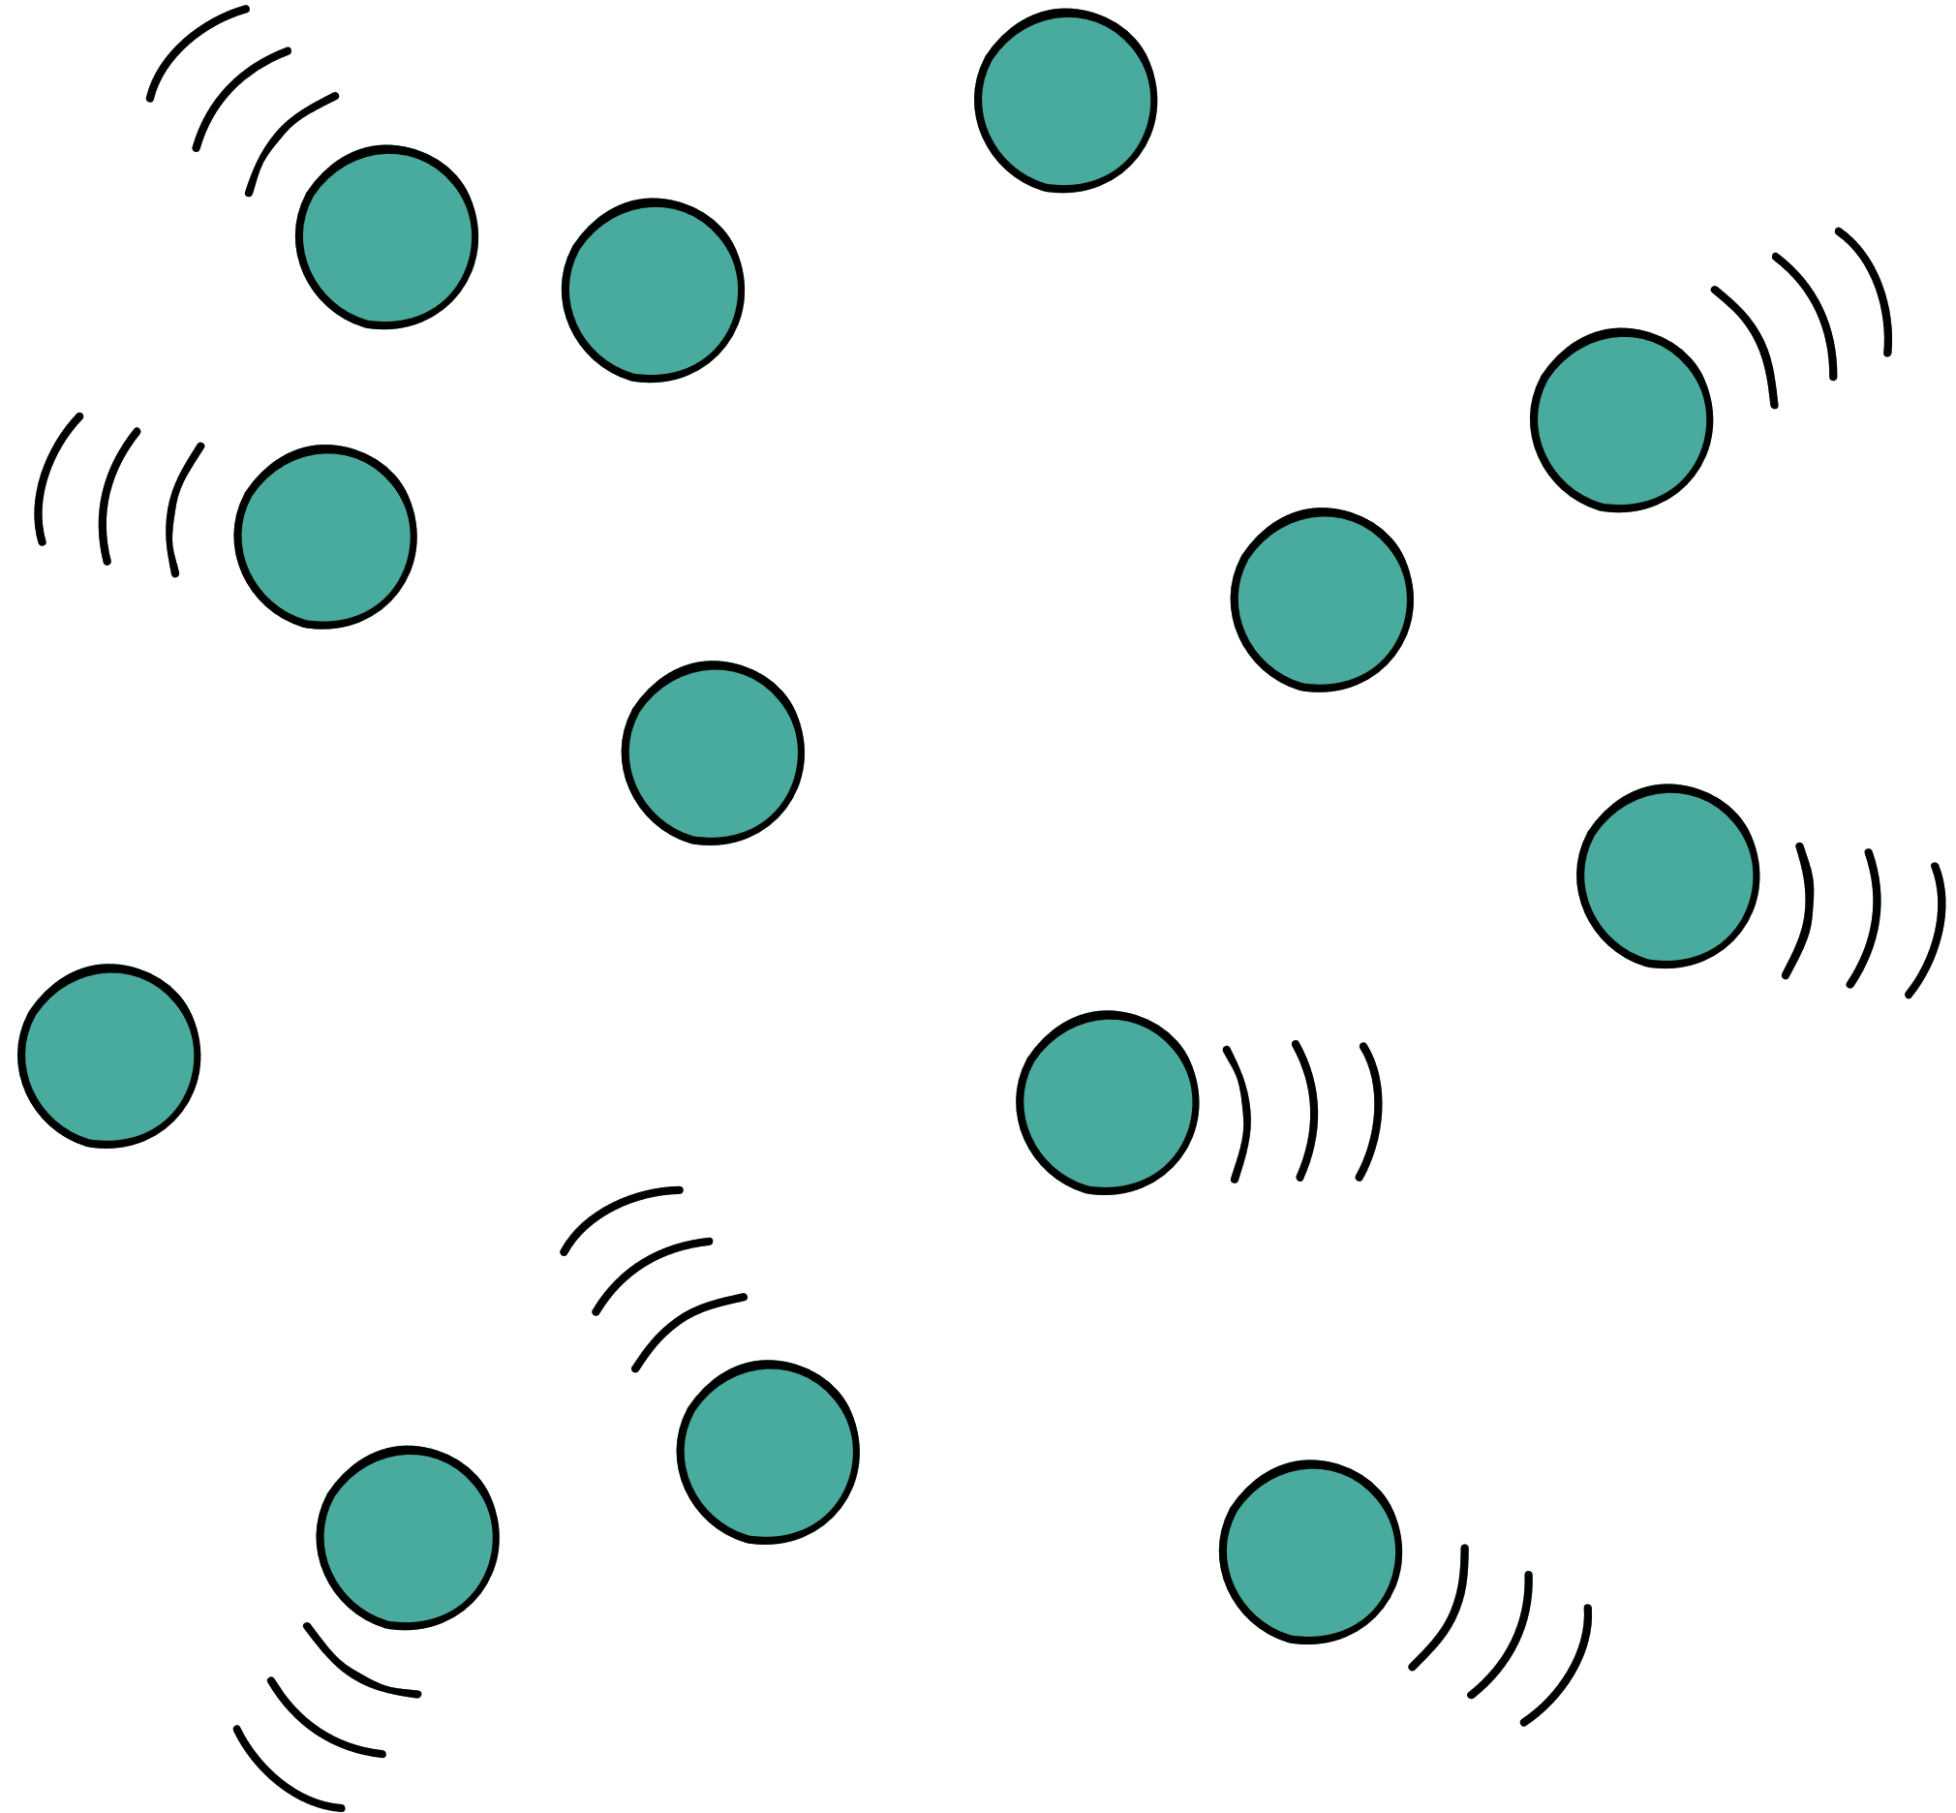

We can stress will or would to criticise people's characteristic behaviour or habits:
She will leave all the lights on in the house when she goes out.

Slide 12
We don't use would in this way to talk about a particular occasion in the past.
.
Last night I gave him a problem and he solved it for me. {not ...he would solve it...)

Slide 13
If we want to talk about things that happened repeatedly in the past, but don't happen now, we
can use would or used to + infinitive.
Tim would / used to visit his parents every other weekend

Slide 14


when we talk about past states that have changed
Used to
In more formal negative and question forms
,

Slide 15

USE OF MAY /MIGHT/CAN/COULD
Possibility
In affirmative sentences we use may or
might or could to say there is a possibility of something happening or being true
There may/might/could be some cake left. I'll go and look

Slide 16

We don't use may to ask questions about the possibility of something happening.
Instead, we use could(n't)
e.g. Could it be that you don't want to leave?

Slide 17
Use of can/could in negative sentences
we use may not or might not to say that it is possible that something is not true,
and can't or couldn't to say that it is not possible that something is true.
.

Slide 18

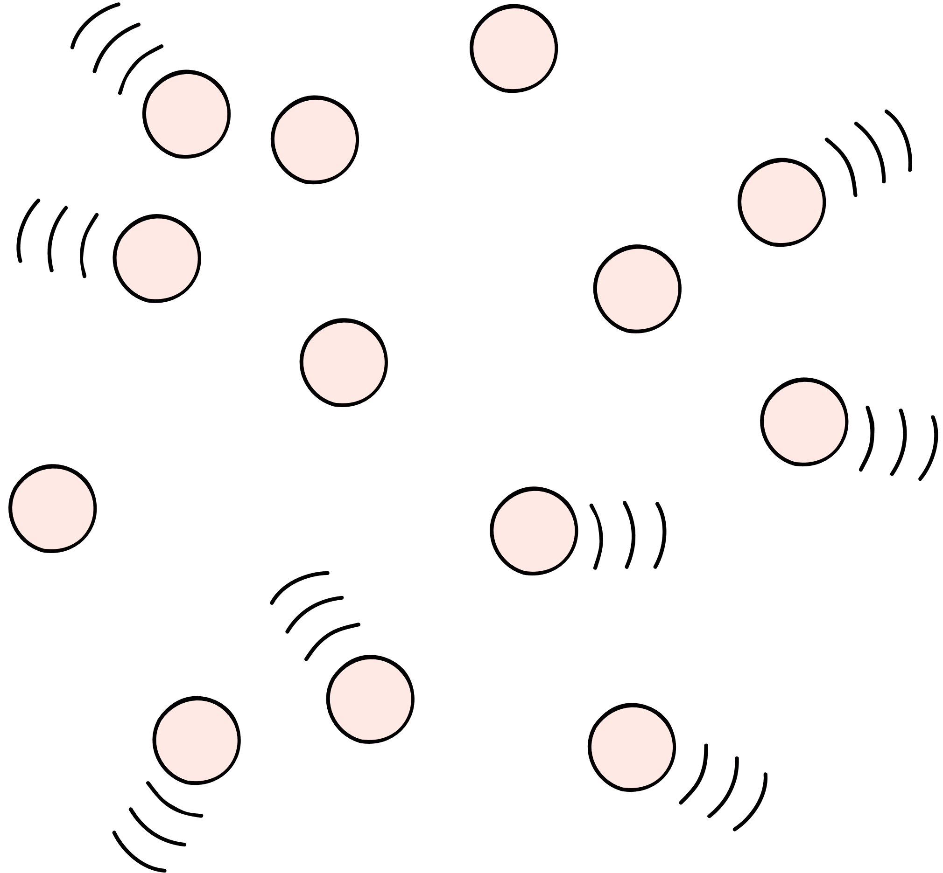
We use may/might (not 'can') + have + past participle to say that by some time in the future, it is possible that something will have happened:
e.g. By next Friday I may/might have completed the report.

Slide 19
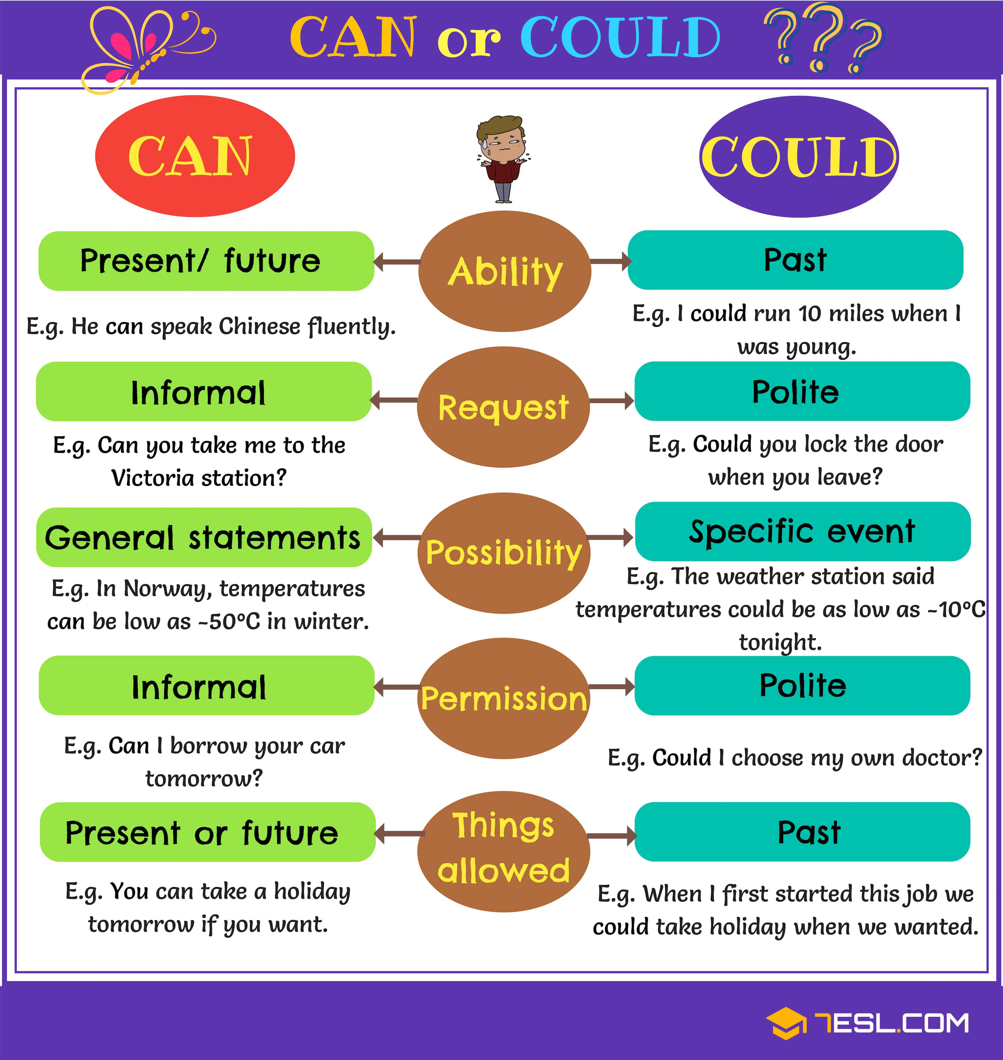


Slide 20
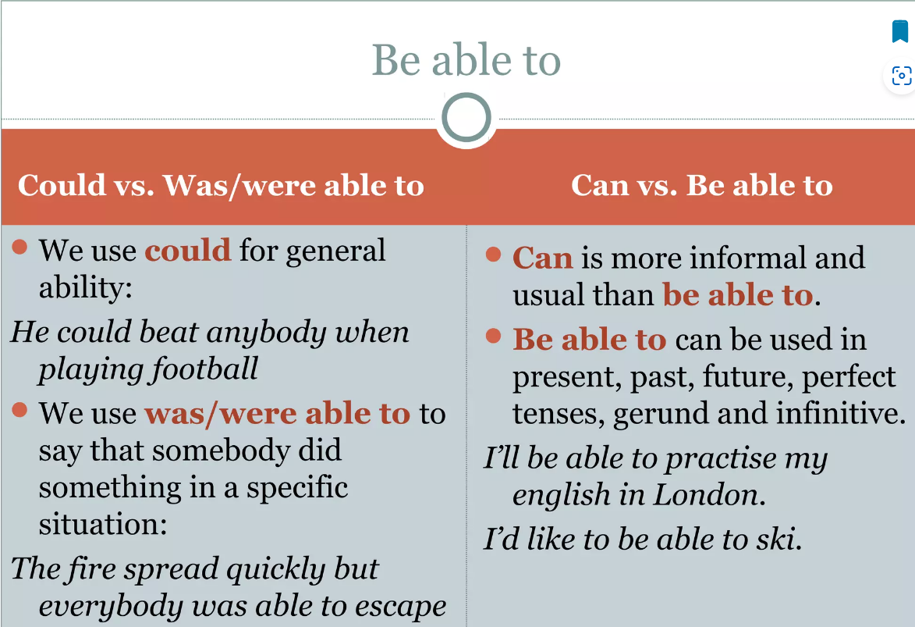

Slide 21
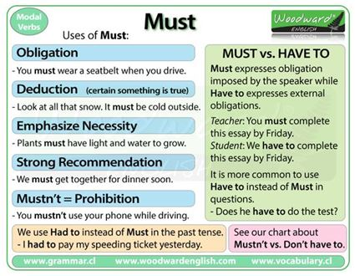

Slide 22
Need(n’t), don’t have to and mustn’t.
We use mustn't to say that something is NOT ALLOWED and needn't (or don't need to) or don't have to to say that something is NOT NECESSARY:
e.g. We needn't go into details now, but we seem to agree on the general principles

Slide 23
Permission
To ask permission to do something: We use can/could
To give and refuse permission, we use can/can’t
Can is used for Present/future; Could is used for Past
Fo

Slide 24

Offers
When we OFFER to do something, or offer by making a suggestion, we can use can or could:
We also use shall/should in questions that request confirmation or advice:
We can use Would (you) like when we make an offer, but not 'Will...'

Slide 25
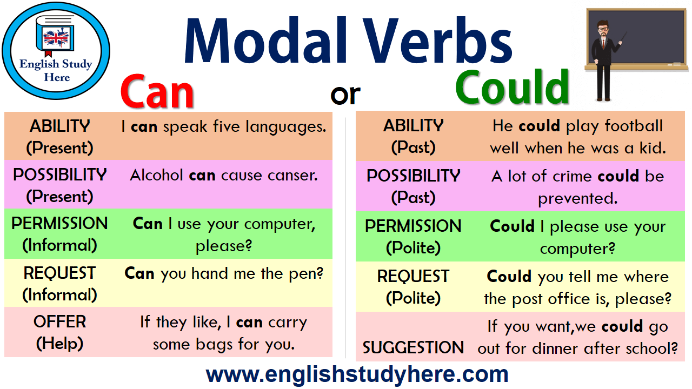
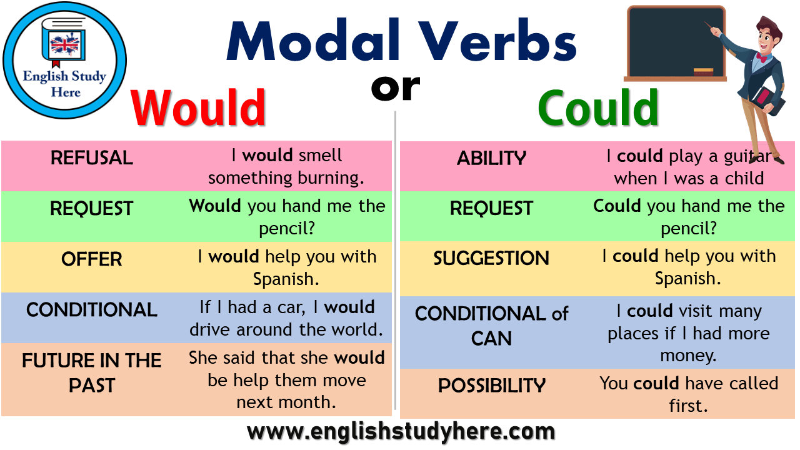

Slide 26
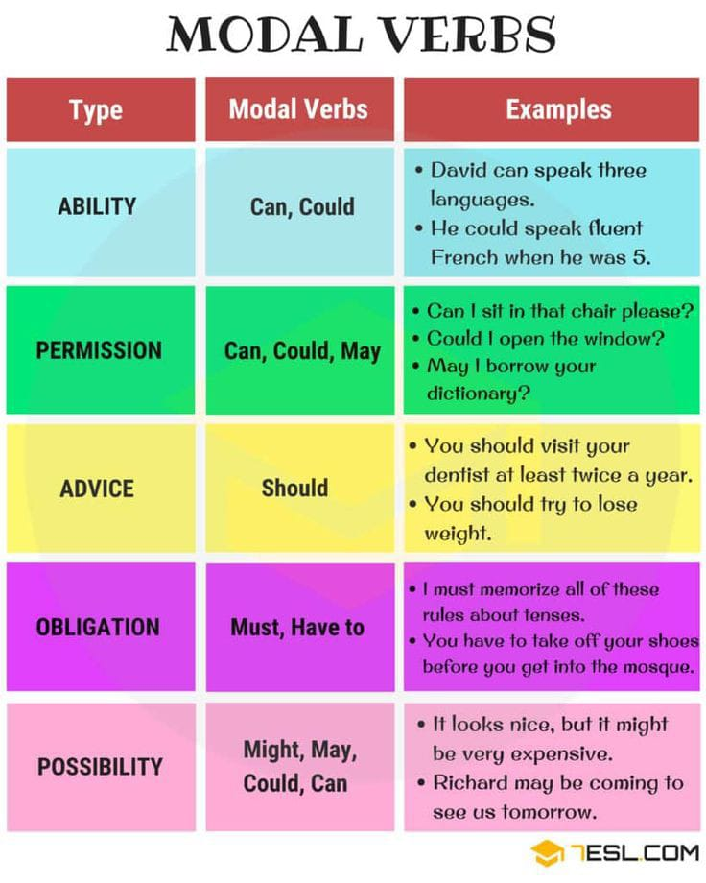

Slide 27
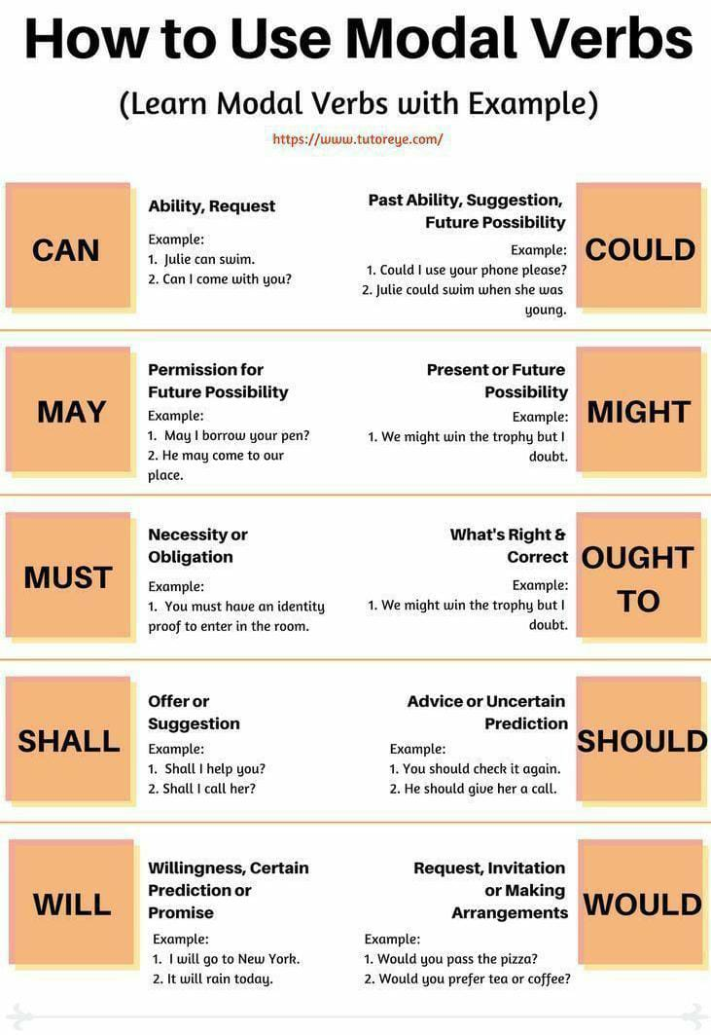

Slide 28
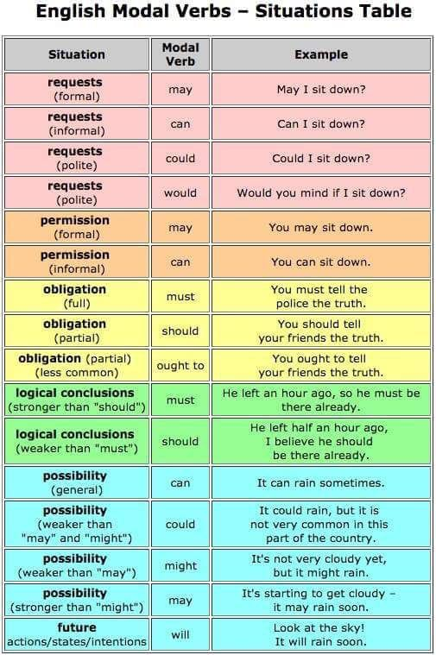

Slide 29
Thank you

